Slide 1
Unit 6 #Sustainable Development and Human Resource Management

Slide 2
Learning Outcomes
After attending this Unit the students will be able to
Comprehend the need for Sustainable HRM Practices
Implement Gender Sensitization measures @ workplace
Conduct Gender Neutral behavior, Recognize Deviance and Initiate Corrective Action
Analyze Organizational Culture with Organizational Culture Assessment Instrument (OCAI)
Demonstrate Culture Sensitive behavior in VUCA World
Illustrate and Promote Employee Engagement

Slide 3
Learning Outcomes
After attending this Unit the students will be able to
Comprehend the need for Sustainable HRM Practices
Implement Gender Sensitization measures @ workplace
Conduct Gender Neutral behavior, Recognize Deviance and Initiate Corrective Action
Analyze Organizational Culture with Organizational Culture Assessment Instrument (OCAI)
Demonstrate Culture Sensitive behavior in VUCA World
Illustrate and Promote Employee Engagement

Slide 4
Sustainable Development Goals (SDG)
Sustainable development is meeting the needs of the present generation without compromising the ability of future generations to meet their own needs.
United Nations Development Program : 17 SDGs

Slide 5
Sustainable HRM

Slide 6
Sustainable HRM
Limitations of the Traditional Market Model
Slowly but gradually, the view is gaining wider acceptance that an overly strong focus on a rather short-termed efficient and effective exploitation of natural, social and human resources in organizations – as suggested by the traditional market Model – is not enough to ensure organizational viability in the long run.

Slide 7
Sustainable HRM
It is not only the focus on short term performance but also the neglect of engaging more actively in the renewal, regeneration and reproduction of resources that organizations need to survive in the long-term.
Companies are dependent on resources (Pfeffer and Salancik 2003) and the depletion of resources reduces an organization’s ability to survive.
Using organizational resources in an efficient and effective way is necessary but not sufficient to ensure long-term corporate viability.
Instead, organizations need to re-think the way they are using and managing their resources – amongst them their current and potential future human resources including social relations outside the organization (which we call the ‘human resource base’).

Slide 8
Sustainable HRM : the Objectives
Attracting and retaining talent and being recognized as an ‘employer of choice’
Maintaining employee health and safety
Investing into the skills of the workforce on a long-term basis by developing critical competencies and lifelong learning
Supporting employees’ work-life-balance and work-family-balance

Slide 9
Sustainable HRM : the Objectives
Managing aging workforces
Creating employee trust, employer trustworthiness and sustained employment relationships
Exhibiting and fostering (corporate) social responsibility towards employees and the communities in which they are operating
Maintaining a high quality of life for employees and communities.

Slide 10
Sustainable HRM Practices
Price Waterhouse Coopers (PWC) published a report on ‘Managing tomorrow’s people’ in 2007
One of their four key scenarios for the future of work and for attracting the generation Y talents describes
Enterprises with a strong focus on sustainability, green management and social responsibility.
Emphasizing the importance of HRM, PWC recommends that a robust and transparent corporate sustainability strategy should be linked with the organization’s people strategy and employee engagement..

Slide 11
Sustainable HRM Practices
KPMG (2011) observes, when discussing its audit provision, that in the process of engaging in sustainability financial corporate reporting no longer is a stand-alone function.
Instead, finance is increasingly integrated with sustainability and corporate social responsibility reporting.
Again, this could be interpreted as pointing towards the importance of Sustainable HRM because many of the data reported such as number of employees participating in human resource development practices, number of absent and sick employees or turnover rates are data coming from the core of HRM engagement..

Slide 12
Sustainable HRM
The importance of sustainability for HR practice and research has a double role (Cohen et al. 2012).
First, in the role of developing and implementing sustainable work and HRM systems (Sustainable HRM)
Second, in the role of supporting the implementation of corporate sustainability strategies – a task that is so far largely in the realm of sustainability or Corporate Social Responsibility executives and departments.

Slide 13
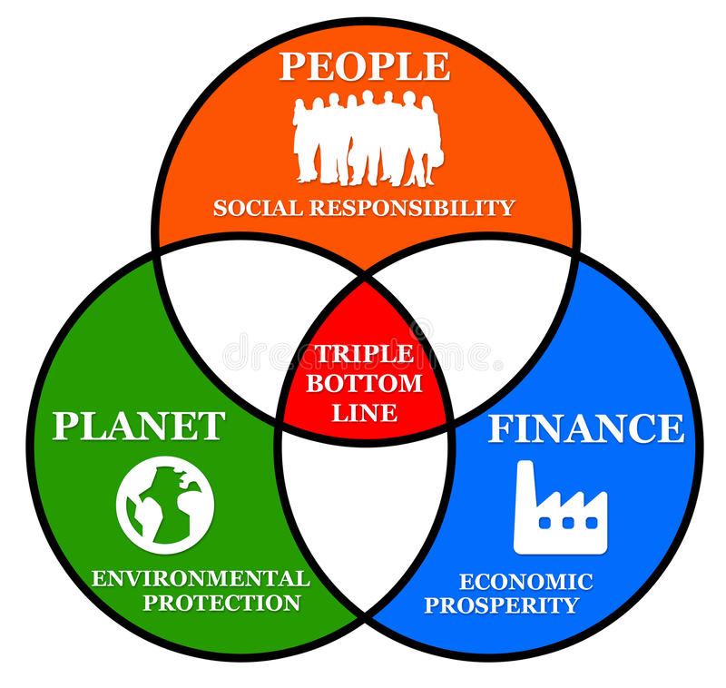
Sustainable Business : the Triple Bottom Line

Slide 14
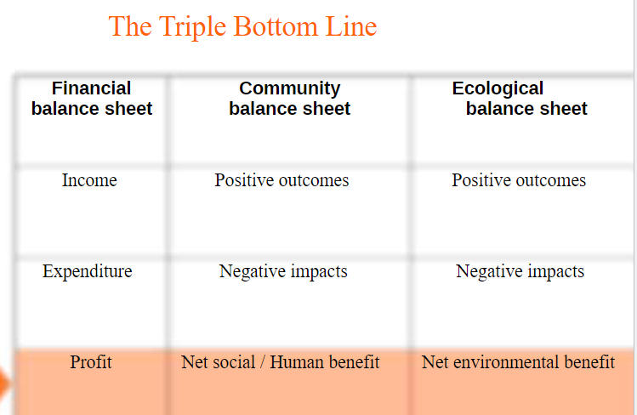
Sustainable HRM Practices

Slide 15
Gender Equality

Slide 16
What Does Gender Equality Mean?
In a holistic view, gender equality in the workplace happens when everyone has equal rights, opportunities, responsibilities, and access in the organization. Specifically, this also means that:
Everyone feels safe pursuing the same job without fearing discrimination
People across teams work together and collaborate equally
Everyone is treated with fairness and respect
Everyone has access to education and training within the organization

Slide 17
Gender Equality in India : A Report by UNICEF
Notes:
https://www.unicef.org/india/what-we-do/gender-equality

Slide 18
Gender inequality in the workplace takes many forms —
unequal pay
disparity in promotions
incidents of sexual harassment, and racism.

Slide 19
A Status Report
According to a report by TeamLease (2016), more than 72% of women feel gender discrimination is still prevalent at workplace.
A recent World Economic Forum report shows that only 14.3% of science researchers in India are women
In India, data from the National Sample Survey Organisation (NSSO) shows that the percentage of women working in finance, insurance, real estate and business services, which includes informational technology services, is only 13.4% across rural and urban populations
Source : https://www.business-humanrights.org/en/latest-news/india-various-reports-highlight-prevalence-of-gender-gap-in-workplace/

Slide 20
A Status Report
Unequal pay
Equal pay for men and women is still not a reality. In 2020, women earned 84% of what men earned for the same job, and Black and Latina women earned even less.
There are multiple reasons that keep women from choosing higher-paying roles and male-dominated industries - unequal access to education, and discrimination.
Source https://www.betterup.com/blog/gender-inequality-in-the-work-place

Slide 21
Gender Neutral Behavior
Gender Biases that Shape our Brains
Notes:
https://www.bbc.com/future/article/20210524-the-gender-biases-that-shape-our-brains

Slide 22
Gender Neutral Behavior
Recognize Deviance and Initiate Corrective Action
Prevention of Sexual Harassment at Workplace Act (2013) – POSHA

Slide 23
Organizational Culture

Slide 24
Learning Objective
After doing this section students will be able to
Comprehend the purpose of organizational culture
Create and sustain an enabling organizational culture

Slide 25
Henry Mintzberg on Culture
“Culture is the soul of the organization — the beliefs and values, and how they are manifested. I think of the structure as the skeleton, and as the flesh and blood. And culture is the soul that holds the thing together and gives it life force.”
Dominant Culture
Expresses the core values that are shared by a majority of the organization’s members.
Subcultures
Tend to develop in large organizations to reflect common problems, situations, or experiences.

Slide 26
Purpose of the Organizational Culture
The pattern of shared values, beliefs, and assumptions considered to be the appropriate way to think and act within an organization.
Culture is shared
Culture helps members solve problems
Culture is taught to newcomers
Culture strongly influences behavior

Slide 27
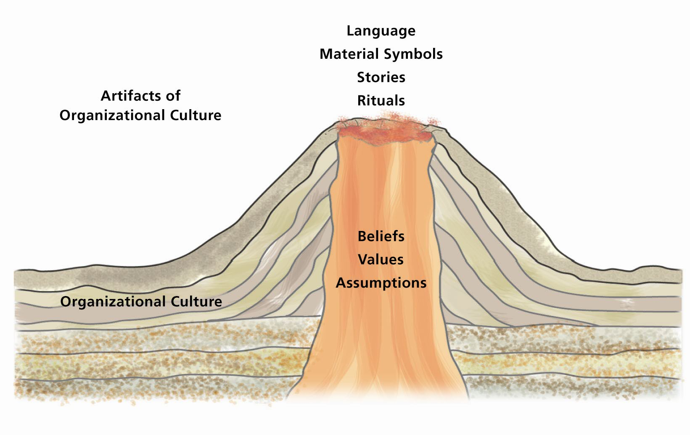
Layers of Culture

Slide 28
Levels of Culture
Artifacts
Aspects of an organization’s culture that you see, hear, and feel
Beliefs
The understandings of how objects and ideas relate to each other
Values
The stable, long-lasting beliefs about what is important
Assumptions
The taken-for-granted notions of how something should be in an organization

Slide 29
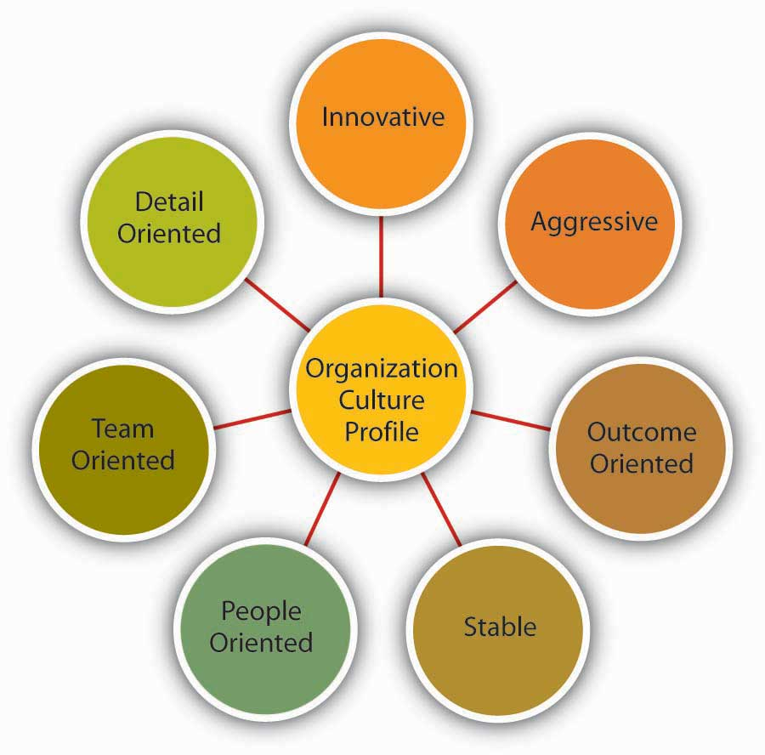
Characteristics of Organizational Culture

Slide 30
Characteristics of Organizational Culture
Innovation and risk-taking: The degree to which employees are encouraged to be innovative and take risks.
Employee orientation: The degree to which employees are expected to exhibit precision, analysis, and attention to detail.
Outcome orientation: The degree to which management focuses on results or outcomes rather than on technique and process.
People orientation: The degree to which management decisions take into consideration the effect of outcomes on people within the organization.
Team orientation: The degree to which work activities are organized around teams rather than individuals.
Aggressiveness: The degree to which people are aggressive and competitive rather than easygoing.
Stability: The degree to which organizational activities emphasize maintaining the status quo in contrast to growth.

Slide 31
Contrasting Organizational Cultures
Organization A
Organization B
•
Managers must fully document
•
Management encourages and
all decisions.
rewards risk-taking and change.
•
Creative decisions, change, and risks
•
Employees are encouraged to
are not encouraged.
“
run with
”
ideas, and failures are
treated as
“
learning experiences.
”
•
Extensive rules and regulations exist
•
Employees have few rules and
for all employees.
regulations to follow.
•
Productivity is valued over employee
•
Productivity is balanced with treating
morale.
its people right.
•
Employees are encouraged to stay
•
Team members are encouraged to interact
within their own department.
with people at all levels and functions.
•
Individual effort is encouraged.
•
Many rewards are team based.

Slide 32
How Organizational Culture Forms
Top
Philosophy
management
of
Selection
Organization's
organization's
criteria
culture
founders
Socialization

Slide 33
Creating and Sustaining Culture
Selection
Identify and hire individuals who will fit in with the culture.
Top Management
Senior executives establish and communicate the norms of the organization.
Socialization
Organizations need to teach the culture to new employees.

Slide 34
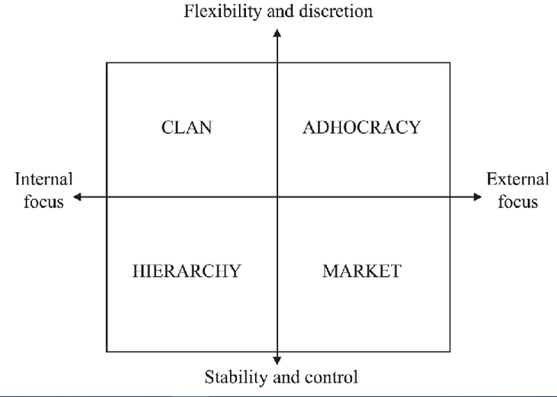
Organizational Culture – 4 Types
Competing Values Framework : Cameron and Quinn

Slide 35
Organization Culture
OCAI by Cameron and Quinn

Slide 36
Organization Culture
OCAI by Cameron and Quinn

Slide 37
WORK ENGAGEMENT

Slide 38
WORK ENGAGEMENT
“A positive, fulfilling, work-related state of mind that is characterized by vigor, dedication, and absorption” (Schaufeli et al., 2002, p. 74).
Individuals who are engaged in their work have high levels of energy, are enthusiastic about their work, and are completely immersed in their work activities

Slide 39
What engages people?
Research has shown that
Workers are most engaged during challenging two-hour work episodes (Reina-Tamayo et al., 2017)
During workdays preceded by evenings when workers have recovered well (Sonnentag, 2003)
During workdays when they have access to a variety of resources (Bakker, 2014)

Slide 40
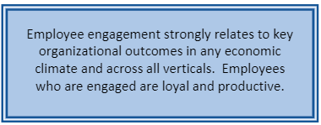
Outcomes of Work Engagement

Slide 41
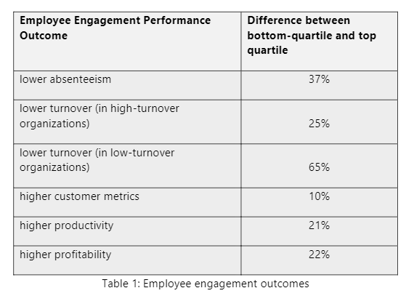
Outcomes of Work Engagement
SOURCE : https://www.researchgate.net/publication/326975125_Employee_Engagement_in_Higher_Education

Slide 42
3 PERSONAS OF ENGAGEMENT
ENGAGED
NOT ENGAGED
ACTIVELY DISENGAGED

Slide 43
THE ENGAGED
Highly involved and enthusiastic about their work and workplace
Psychological Owners
Drive Performance and Innovation
Take Organization Forward

Slide 44
NOT ENGAGED
Psychologically unattached to their work and workplace
They put in time but not energy and passion
They do complete their work but are not ready to shoulder higher responsibilities / continuously innovate in current role.

Slide 45
DISENGAGED
They are not just unhappy, they are resentful that their needs are not being met.
They talk negatively about co-workers, ongoing projects, actively search for alternate employment
Everyday, they potentially undermine what engaged workers accomplish

Slide 46
The need for Work-Life Harmony
Matt Bloom from University of Notre Dame reported
According to Gallup’s World Poll, 63% of the global workforce is “checked out” and “sleepwalking through their workday.”
“More than two-thirds of Americans find work as the single most stressful thing in their lives,” says Bloom.

Slide 47
6 ways to achieve work-life harmony
Section

Slide 48
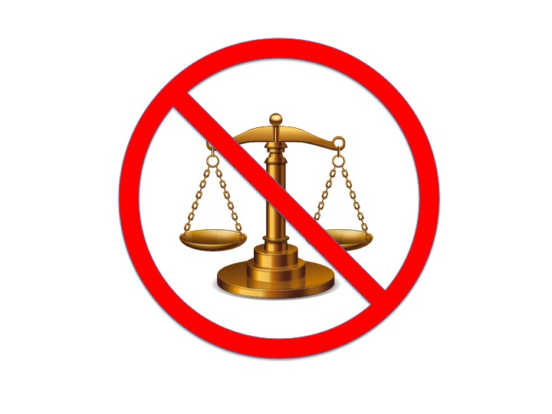
6 ways to achieve work-life harmony
Stop Searching for Balance
This Photo by Unknown Author is licensed under CC BY-NC

Slide 49
6 ways to achieve work-life harmony
2. Be Present in the Moment
If you’re at work, focus on the activity at hand and give it your all.
When you’re with family, leave work matters out of your mind.

Slide 50
6 ways to achieve work-life harmony
3. Plan Your Week Around Your Priorities or “Themes”
Take twenty minutes on a Sunday evening to establish the priorities that will guide the upcoming week.
These should be specific, actionable goals that you’re prepared to have accomplished by the time Saturday rolls around.

Slide 51
6 ways to achieve work-life harmony
4. Make Conscious Choices
“Everything has a PRICE TAG”
Notes:
These days, those who “grind” in their careers are put on a pedestal.
Although being determined and hardworking is admirable, it’s easy to neglect other aspects of your life that are equally as important.
Is it really worth it?

Slide 52

6 ways to achieve work-life harmony
5. Stay Active
Notes:
Regular aerobic exercise that gets your heart pumping (running, biking, swimming, hiking) is proven to increase the size of the hippocampus—the area of the brain that deals with verbal memory and learning.

Slide 53
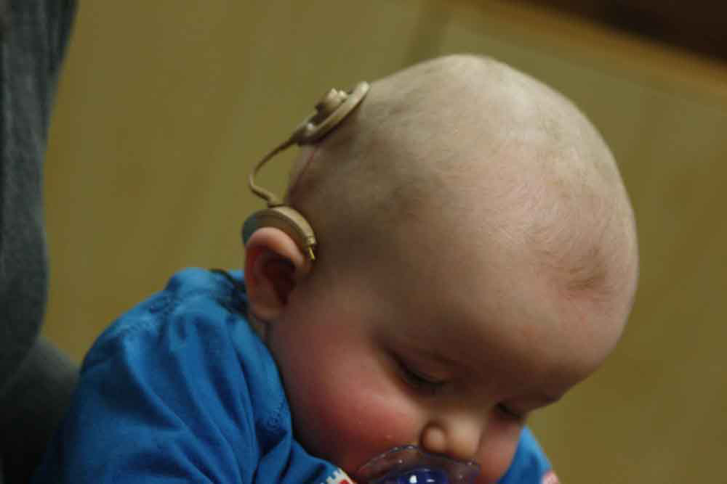
6 ways to achieve work-life harmony
This Photo by Unknown Author is licensed under CC BY
6. Get Rest
Foregoing regular sleep (7-8 hours)
prevents the brain from making new memories
weakens the immune system
slows down the brain’s ability to process information

Slide 54
Refrences
https://templetonreligiontrust.org/explore/work-and-purpose-arent-ememies/?gclid=CjwKCAjw-qeFBhAsEiwA2G7Nl41PsoXSNMWlz0s5LfCTmVwqsRqQfOI_c-ZOtluzfVHAdKrcySkrxxoC_DIQAvD_BwE
http://www.drryanduffy.com/uploads/3/1/7/2/31724447/duffy_et_al.__2018_.pdf
https://kashoo.com/blog/6-ways-to-achieve-work-life-harmony/

Slide 55
Important Link
https://www.youtube.com/watch?v=_QqT38QRA84-
The 'Google' Life
https://www.youtube.com/watch?v=-6wCUQC44cA
Apple Company Culture
https://www.youtube.com/watch?v=X1dmVox38_w
How To Transform Your Company Culture And Attract Brilliant Talent
https://www.youtube.com/watch?v=F2lzcilkw_c
Corporate culture And what does corporate culture have to do with business ethics?

Slide 56
Leadership in the age of AI

Slide 57
Organizational leadership is evolving with changes in technology.
Leaders realize that they must adapt to these changes faster.
New technologies like Artificial Intelligence (AI) have changed the nature of leadership.

Slide 58

Shift in Leadership Decisions
With the use of AI, leaders will focus less on the cognitive processing of facts and information.
They will focus more on the human aspects like personality characteristics and behaviors.
This will help improve the engagement and performance of staff and increase operational efficiencies in order to improve the company's bottom line.

Slide 59
Example
McKinsey and Company article explains one application of AI to a corporate decision-making process.
A CEO reached out to his data analytics team to use AI to answer a few open-ended questions in a problem .
The analytics team conducted the required analyses, which revealed some previously-hidden trends.
These indicated that the communications between the design and engineering departments could use a tune-up.
The data analytics team reported back to the CEO with concrete evidence that poor collaboration led to increased cost and a lack of efficiency.

Slide 60
Summary
AI holds enormous potential for human empowerment.
Future leaders can utilize this tool to spot patterns within new and existing data and uncover important insight that can positively impact the bottom line.
They can also automate redundant tasks, improve process performance and productivity, and positively impact employee engagement and retention.
21st-century leadership needs advanced training from experts who are at the forefront of these industry changes

